Slide 1


Searching the Metabolizing Enzymes and Transporter (MET) module
Retrieving high quality extracted MET data to anticipate safety risk
Marnix Wieffer, Senior marketing manager drug safety
m.wieffer@elsevier.com
https://www.linkedin.com/in/marnix-wieffer/
Notes:
Hello everybody and welcome to this tutorial video where we will show you how you can retrieve high quality extracted metabolizing enzyme and transporter data from the PharmaPendium MET module

Slide 2
Learning objective
How to
Set up a search in the MET module
Explore the MET data results view
Filter and sort MET data
Export and process you results
At the end of this video you should have a good understanding of how to retrieve MET data from the MET module
Recommended watch: https://p.widencdn.net/xqmi6e/PLS_DDD_PP_Customer_training_browsing_for_MET_Data_VID
Notes:
We will show you how to……………………..
At the end of this video you should have a good understanding of how to retrieve MET data using the MET data module . This will help to investigate for example Drug-drug interaction risk, optimize experimental design

Slide 3
Example question
I am developing a new drug and my in vitro studies show that it is processed by the enzyme CYP2D6.
What marketed drug are know to potently inhibit CYP2D6?
Impact: reduce development risk and improve patient safety
Notes:
To explore DDI risk I wonder, What marketed drugs are known to potently inhibit CYP2D6? This information will help me to decide what further preclinical and clinical studies to do, optimize submission and reduce post-market safety risk

Slide 4
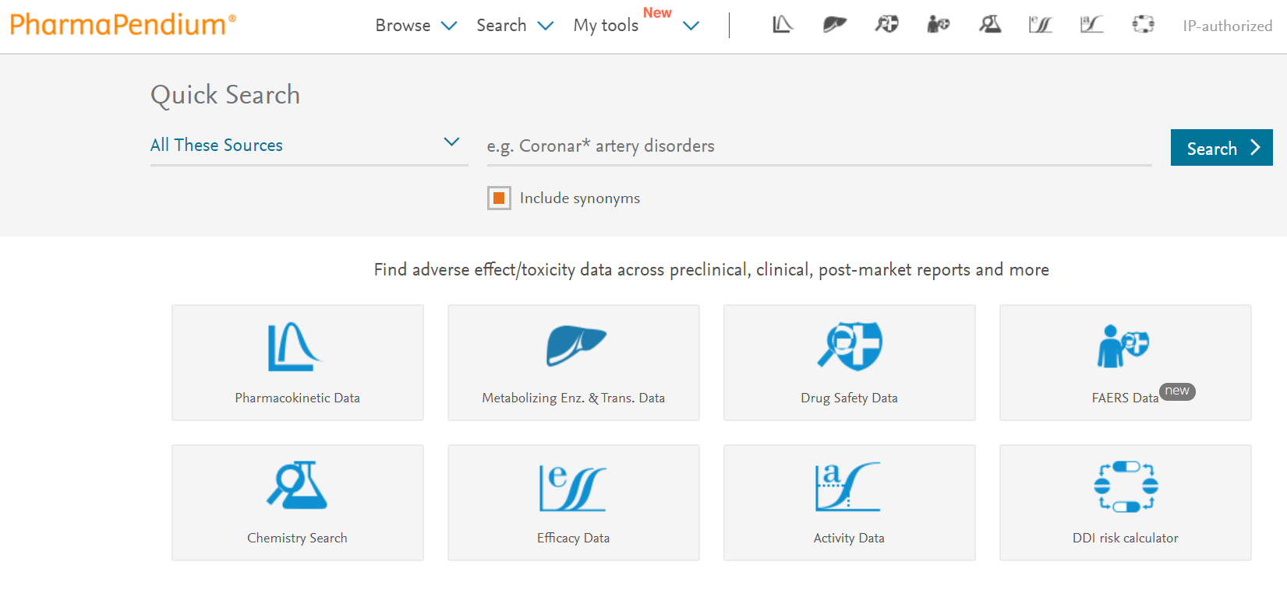
Open the MET module

Slide 5
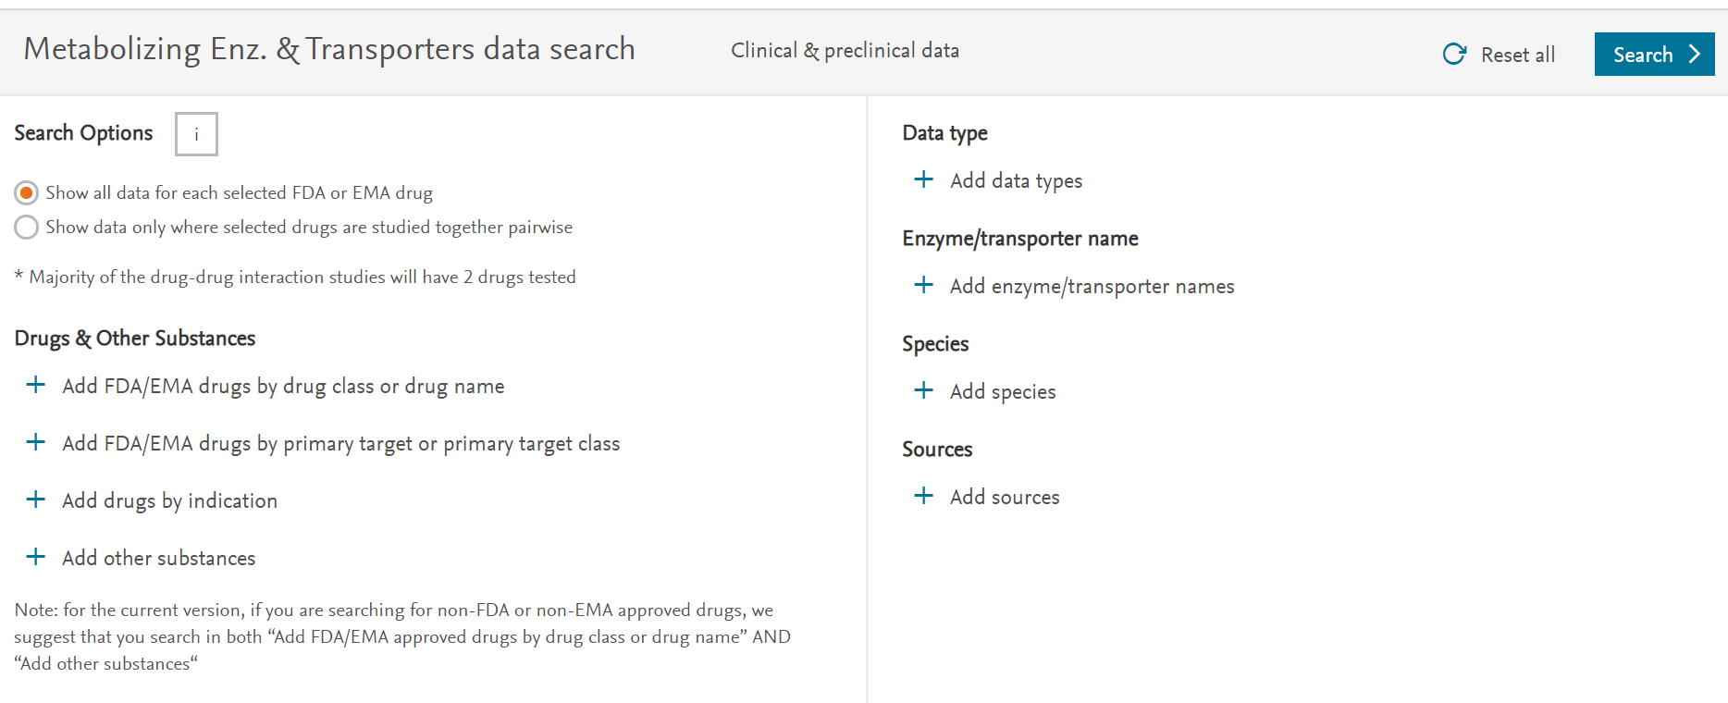
Open the MET module
Notes:
Separate session on “Show data only where selected drugs are studied together pairwise

Slide 6
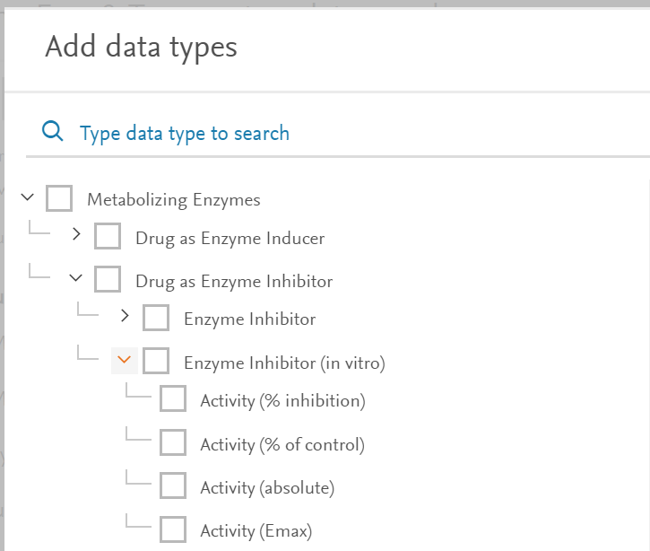
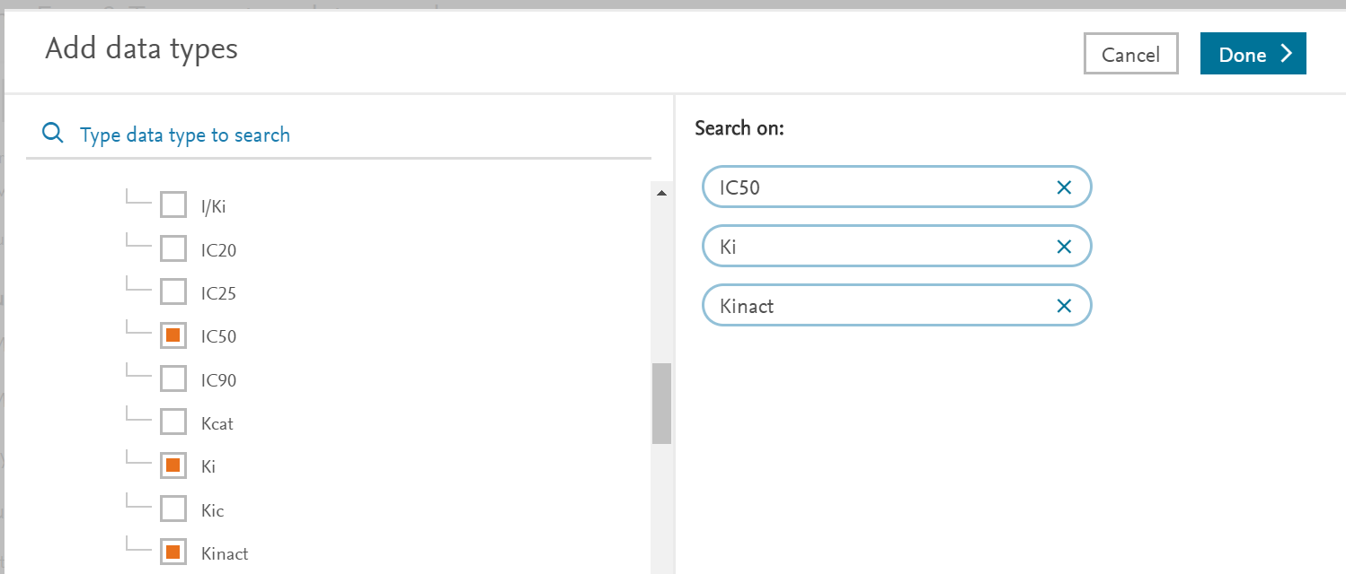
Add data type (parameters) of interest
Notes:
We are interested in finding potent inhibitors for CYP2D6. We can start limiting for this datatype by going to “data-type” is where we are going to limit specifically to information on our drug as an
Enzyme inducer
Enzyme inhibitor
Or Enzyme substrate
If we open up the category Enzyme inhibitor, we can for example limit our search to IC50, Ki and Kinact values. A common used value for enzyme inactivation,
to described mechanism-based inhibitors.
IC50 represents the concentration of a drug that is required for 50% inhibition in vitro.
The inhibitor constant, Ki, is an indication of how potent an inhibitor is; it is the concentration required to produce half maximum inhibition
IC50 values is a suitable quantity for reversible inhibitors but concerns arise when dealing with irreversible or mechanism-based inhibitors (MBIs). Therefore, most studies and ranking schemes related to MBIs rely on the inhibition constant (KI ) and the rate of enzyme inactivation (kinact) for mechanism-based inhibitors
you appreciate how many parameters we extract for the MET module, that id
we can

Slide 7
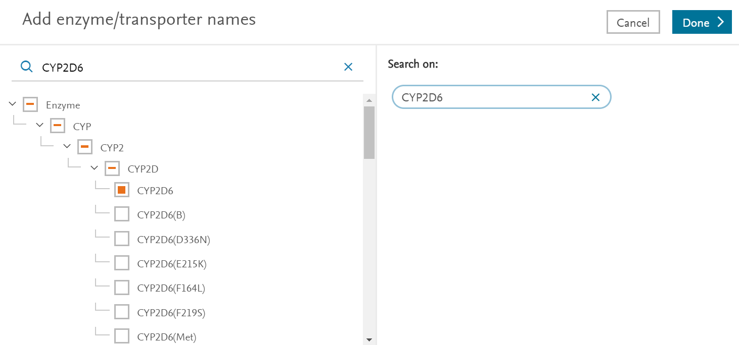
Add enzyme of interest
Notes:
Information on mutations, but also non CYP enzymes and transporters

Slide 8
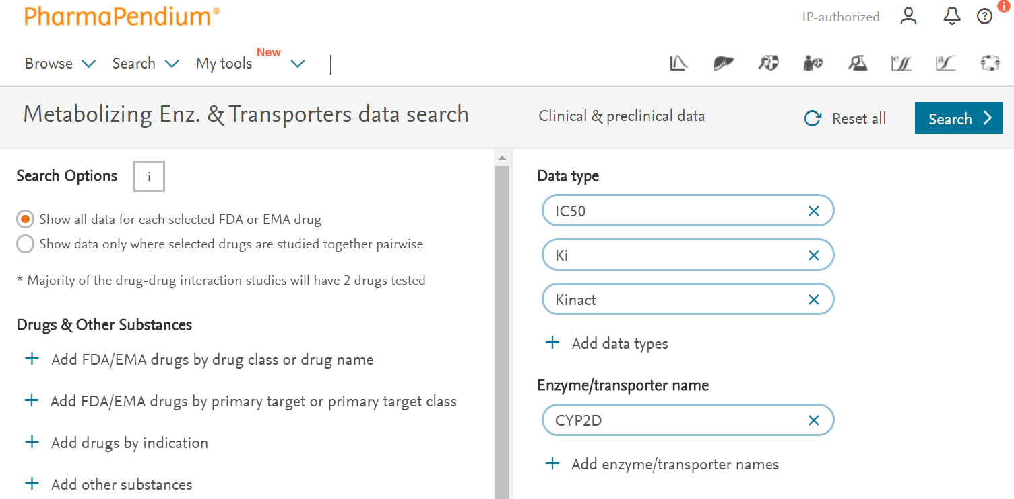
Search for s
Notes:
Find potent inhibitors for CYP2D6, so datatype is where we are going to limit specifically to information on our drug as an
Enzyme inducer
Enzyme inhibitor
Or Enzyme substrate

Slide 9
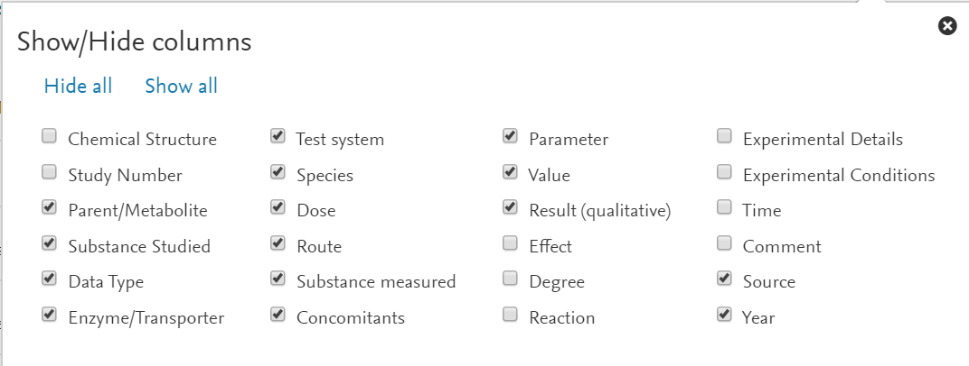
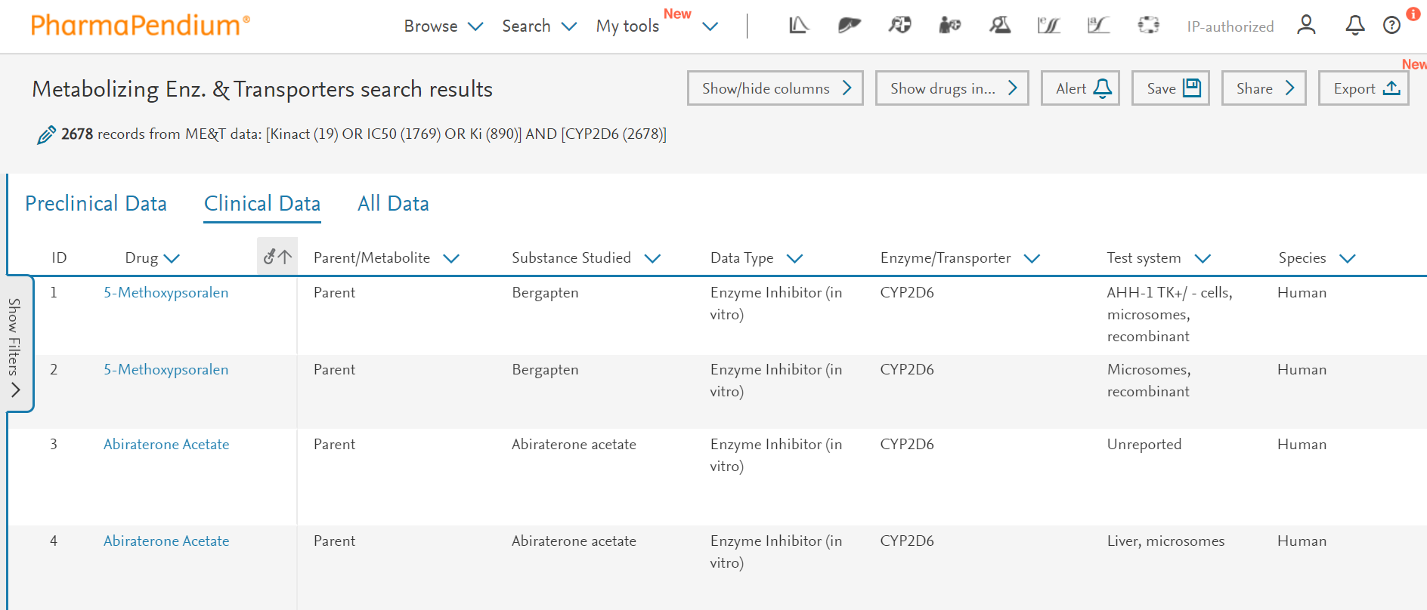
Visualize columns most relevant
Notes:
What we get is tabulated view of 248 preclinical and 2678 records of clincal data on drugs having an inhibitory effect on CYP2D6. We have access to a lot of data including,
…
Species
And route. Let me take a short pause and explain why we find invitro data under clinical. This means that the experiment was performed on human enzymes, and therefore classified as in-vitro clinical data. Now in this example we only have In vitro data. However, if you would have a mix of in vitro and in vivo human data, you filter your dataset by going to route of administration and select invitro or the route of for example “oral administration” to select the in vivo data.
Further we have extrcated out

Slide 10
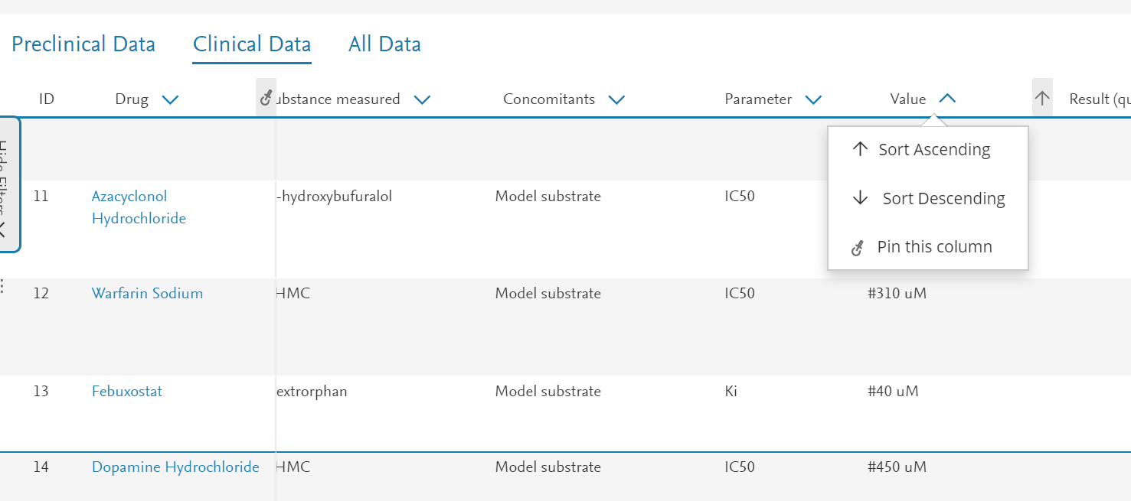
Sort the data if relevant
Notes:
What we get is tabulated view of 248 preclinical and 2678 records of clincal data on drugs having an inhibitory effect on CYP2D6. We have access to a lot of data including,
…
Species
And route. Let me take a short pause and explain why we find invitro data under clinical. This means that the experiment was performed on human enzymes, and therefore classified as in-vitro clinical data. Now in this example we only have In vitro data. However, if you would have a mix of in vitro and in vivo human data, you filter your dataset by going to route of administration and select invitro or the route of for example “oral administration” to select the in vivo data.
Further we have extrcated out

Slide 11
Add enzyme of interest
Set up alert
Save data
Share results
Requires login
Notes:
What we get is tabulated view of 248 preclinical and 2678 records of clincal data on drugs having an inhibitory effect on CYP2D6. We have access to a lot of data including,
…
Species
And route. Let me take a short pause and explain why we find invitro data under clinical. This means that the experiment was performed on human enzymes, and therefore classified as in-vitro clinical data. Now in this example we only have In vitro data. However, if you would have a mix of in vitro and in vivo human data, you filter your dataset by going to route of administration and select invitro or the route of for example “oral administration” to select the in vivo data.
Further we have extrcated out

Slide 12
Add enzyme of interest
Notes:
Unfortunately it is not possible to filter the data in PharmaPendium
Qualitative, a result is often decsribed in a qualitative manner, This information is that information is extracted

Slide 13
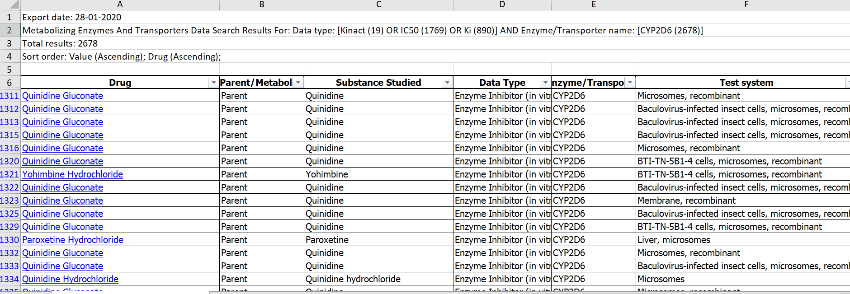
487 lines of data on drug with IC50 <10 uM
Notes:
Unfortunately it is not possible to filter the data in PharmaPendium
Qualitative, a result is often decsribed in a qualitative manner, This information is that information is extracted

Slide 14
Notes:
Hopefully this workflow illustrated how easy is is to retieve critical metablizing and trasnporter data in PharmaPendium that will help you to make informed decision during drug development. With that I would like to thank you for your attention. I case of quetsions, please do not hesitate to get in touch.

